Slide 1
Effective Use of Teaching Assistants
Official research
Classroom practice, strategies and feedback
Interventions, assessment, measuring effectiveness, transition of skills and feedback
TA audits, Professional Development and Appraisals
Notes:
Talk about your experience as a class teacher, an intervention teacher and as a SENCo and now as an ADVISORY TEACHER SEND
TAs have been invaluable to me, my friends, my confident, my support, my PA, my advisor, my equal.
I have had some fantastic TAs and they have followed my plans and my instructions and have developed a greater understanding of SEN types and how to support them – however, many teachers have not had the training that I have had and this is where some of the issues are raised.

Slide 2


Slide 3
Research
Effective Deployment of Teaching Assistants (EDTA) project
Peter Blatchford, Prof. Rob Webster and Dr Anthony Russell
Deployment and Impact of Support Staff (DISS) project
Peter Blatchford, Prof. Rob Webster, Paul Bassett, Penelope Brown and Clare Martin
The Education Endowment Foundation (EEF) Guidance Report Peter Blatchford, Prof. Rob Webster and Dr John Sharples
Making a Statement Project (MaST)
A study of the teaching and support experienced by pupils with a statement of special educational needs in mainstream
primary schools
Prof. Rob Webster and Peter Blatchford
Notes:
4 projects over 3 years
The first three projects investigated classroom practise and interventions
The MaST project focused on the effectiveness of TAs with Statemented pupils specifically (EHCP) it also looked at the involvement of teachers with the same pupils.

Slide 4

What Schools will be advised to use.
The Education Endowment Foundation (EEF) Guidance Report by Peter Blatchford, Prof Rob Webster and Dr John Sharples has suggested documents for auditing the effectiveness of their support staff.
The document is split into 3 areas that should be reviewed with staff at their performance management meetings.
Notes:
Give out the print out of the TA recommendations and the RAG system

Slide 5
TASK
What does you job involve?
Decide the top 3 things that you do; ranking 1 as the highest amount of your time.

Slide 6
RECOMMENDATIONS ON THE USE OF TEACHING ASSISTANTS IN EVERYDAY CLASSROOM CONTEXTS
RECOMMENDATIONS ON THE USE OF TEACHING ASSISTANTS IN
DELIVERING STRUCTURED INTERVENTIONS OUT OF CLASS
RECOMMENDATIONS ON LINKING LEARNING
FROM WORK LED BY TEACHERS AND TAs
Notes:
There are 4 strands in the first section
2 in the second and 1 in the last.

Slide 7
Pedagogical Model
Practice
Deployment
Preparedness
Characteristics
Conditions of employment

Slide 8
Characteristics
Fact
Thoughts
Age, gender, ethnicity, qualifications and experience
Emotionally responsive
TAs need to further their professional development to include:
A change of teacher
A change of year group
Observe good practice
Attend courses and training
Notes:
We all bring something different to the mix – this is a positive
Qualifications do range across the settings, but most schools have asked for the minimum of a level 2 NVQ and new TAs are required to have a GCSE in maths and literacy or an equivalent.
On the whole, TAs do provide a greater pastoral role in the school and this can be comforting for the children and enables teachers to get on with academic matters

Slide 9
Conditions of Employment
Time-tabled sessions for discussion regarding the effectiveness of your role with the class teacher, Key Stage manager, SENCo or Head teacher
Set up reviews, audit of skills and a performance management system with manageable targets
Fact
Relies heavily on the goodwill of TAs and Support Staff
Line and performance management process not fully developed

Slide 10
Preparedness
Senior managers to clarify the role of the TA within the school
How are TAs given their planning?
How are TAs reporting the achievements of the child?
Access training to ensure sufficient literacy and numeracy skills
Training on higher order questioning and the development of learning styles
Fact
Little training for teachers to work with/manage TAs
Lack of planning, preparation and feedback time with teacher
Limited subject knowledge and pedagogical knowledge
Notes:
Preparedness describes two aspects of TAs’ work: 1. The training and professional development of TAs and teachers (e.g., how teachers manage and organise the work of TAs) 2. Day-to-day preparation (e.g., time for joint planning and feedback between teachers and TAs).
Currently teachers are not given training on how to best use their TAs for either class work, interventions or 1:1 it becomes the responsibility of the school to state what they want, if not an assistant is urged to use their initiative
One of the biggest issues for both TAs and teachers is the sharing of their plans, not enough time before school, many assistants also cover lunch duties, needed for childcare at the end of the day, no access to emails.
The same issue arises with feedback from the TA to the teacher
This is a bigger issue in Secondary schools but some assistants struggle with the subject matter.
Pedagogical knowledge – the skills needed in order to assist a child with independent learning and how to extend their critical thinking
Recommendation 4 states that schools should 'ensure that TAs are fully prepared for their role in the classroom'. How can schools best achieve this?
Effective day-to-day preparation is essential. This comes down to finding ways to fully brief teaching assistants ahead of the lessons they will be supporting. All too often there are limited interactions between teachers and teaching assistants, meaning that the TA enters the lesson without a full understanding of teaching methods, strategies or planned outcomes for the lesson.
For TAs to be fully prepared for their role, schools need to find creative ways for teachers and TAs to liaise outside of the classroom.
This poses obvious challenges, as teachers and TAs are already time pressured, so building in facilitated preparation time pre-lessons can be difficult. The report makes a number of suggestions on how schools might achieve this, including adjusting TAs’ working hours (start early, finish early), using assembly time and having TAs join teachers for (part of) planning, preparation and assessment (PPA) time.

Slide 11
Deployment
Teachers must work with the children who are most in need of specialist, pedagogical approaches
Children must stay in class working alongside their peers
Roving the classroom is deemed more effective than working with a group
Teachers need to take charge and responsibility of behaviour
Fact
TAs have a direct instructional, frontline pedagogical role
Routinely support lower attaining pupils and those with SEN
Support pupils 1:1 and in groups, in and away from class
Pupils separated from teacher and mainstream curriculum
Notes:
The recent EEF guidance suggests the need for careful planning when rethinking the use of TAs. What steps should be taken by schools to alter their TA deployment strategy?
As the deployment of staff is a school leadership issue it is important they take overall responsibility for any changes to TAs' roles and practices.
In the report we also outline a school improvement process that schools have successfully used to review and reframe their use of TAs.
Step 1: Thoroughly review current practice to understand how you are currently meeting the needs of those pupils who require additional support. An honest self-appraisal is a crucial step to recognising where change is necessary.
Step 2: Define the role, purpose and contribution of teaching assistants across your school.
Step 3: Develop a whole-school approach to improvements. Introduce change gradually, testing ideas and ensuring staff across the school are supporting the new system and that they themselves are also supported.
Step 4: Once this whole-school approach involving all staff is in place, you can begin to provide your teaching assistants with the appropriate training and support. Providing this training before you have got the context right, for their work is unlikely to have maximum effect. But once a well thought out improvement plan is in place this training is an essential step towards pupil progress.

Slide 12
Classroom Practice
Work with low attaining children
Prioritise task completion over learning
Reactive not proactive role
Close down discussion
Manage unwanted behaviours
Notes:
Close down discussion
It’s not that TAs are stopping students from talking, it’s that they give answers when the child isn’t forthcoming with ideas or that their thoughts aren’t detailed enough. This is where higher order questioning skills (Blooms Taxonomy) come in useful along with processing time for the child to generate a response.
Work with low attaining children
Evidence from the DISS project has come to light that ‘It was found that pupils who received the most support from TAs made less progress in core subjects over a school year than similar pupils who received less support from TAs.’

Slide 13
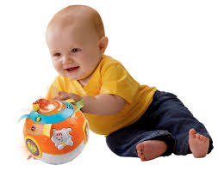
Experimental Research
Notes:
Clinical psychologists carried out and experiment
Two rooms, several babies in succession and a toy that had 4 functions, flashing lights, noises etc
One group of babies were shown the toy by the psychologist, they pressed a button and the toy made a noise.
The second group were given the toy
The first babies played with the toy by continuously pressing the button to hear the noise
The other babies pressed, rolled and shook the toy to find that it had more than one function

Slide 14
Strategies for Success
Let the children enquire
Assist with understanding through questioning
Use the WDEP method to support children
Rotate around ability groups
Use teacher ‘delivery time’ effectively
Notes:
Blooms Taxonomy
WDEP
W= What do you want? Want
D= What were you doing? Doing
E= Did what you were doing get you what you wanted? Evaluation
P= Do you want to make a plan for next time? Plan
Delivery time – that time when the teacher introduces the topic/objectives and success criteria
Whispering prompts and ideas, so that the whispers eventually become their own
Take the child to the side, back and talk through the points that the teacher is making, maybe look through some visuals, a scaffolding plan to aid writing, physical resources to gain answers
Please note that there were findings that 80% of the teachers interviewed in the research project were found to have insufficient knowledge of the types of SEN within their class, especially those with an EHCP/Statement

Slide 15
Feedback
To the student
To the teacher
What does that look like?
Notes:
This is an essential part of your job.
At the moment a percentage is given about how much support has been given. How can this be improved upon?
Post it notes?
Marking children’s work in line with the school policy
2 stars and a wish; focusing on the objective
Discussing the strengths and future targets for that child can be detailed as verbal feedback but the teacher needs to know that so a comment needs to be written somewhere to inform future planning. If not written then verbal feedback to the teacher.

Slide 16

Group work & focus of intervention
Spelling
Reading
Comprehension
Writing
Handwriting
Number
Notes:
Interventions were deemed to be good where there was a structured resource that set out an order of progression
Examples
Alpha to Omega
Read, Write Inc
Blaze – Rising Stars

Slide 17
Effective Interventions
APDR
Assess
Plan
Do
Review

Slide 18
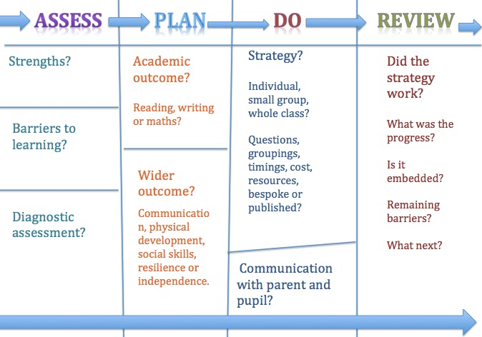
APDR
Notes:
This process is in line with the new Code of Practice 0-25

Slide 19

Assessment
Recognised test with standardised score
Spelling SWST HAST VERNON
Reading & Comprehension
DRA, Edinburgh, YARC, Neale Analysis,
NFER, WRAT4 EDINBURGH
Writing
Individual assessment or DASH
Handwriting
Individual assessment

Slide 20
Planning
Benchmark ability
Strengths and weakness analysis
Learning style
Interests
Timing (brief & regular)
Longevity (sustained)
Progress measured
Group size
Timetabled & structured.
Feasibility

Slide 21
Devise a Programme
Spelling: SWST for progression, different methods. (VAK)
Reading: Phonics/Whole word approach for decoding, practise for automaticity.
Comprehension: Opportunities for summarising, sequencing, inference, deduction.
Writing: Structure, check understanding, orally rehearse, subject specific, model and scaffold, orally rehearse, EXPLICIT.
SPAG: Scaffold sentence structure and parts of speech; model the use of specific punctuation, crib sheet of grammatical terms
Handwriting: Physical approach, analysis of style
Numeracy: Repetition of number bonds 1-10, 1-20, 1-100 using different units
of measure, repetition of multiplication knowledge using VAK methods

Slide 22
Session details
Ice breaker/settling in
Revision
New teaching point – Fun games/success
Whole picture/Context
Recap
Feedback
Follow up

Slide 23
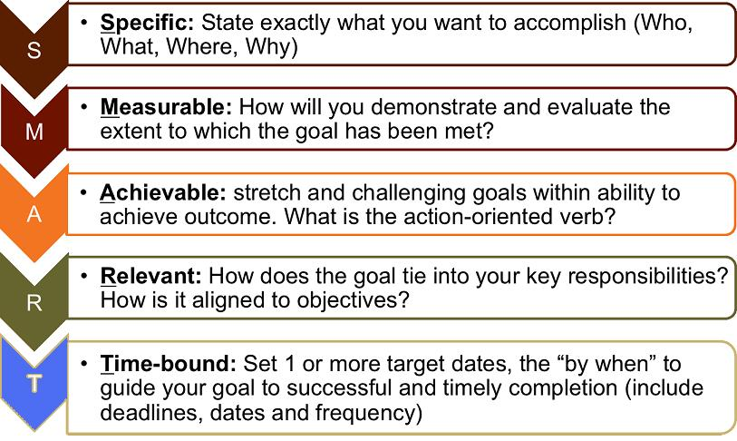
SMART Targets

Slide 24
TASK
Sort the statements into Vague and SMART targets

Slide 25
Reporting Change or Progress
How do you report back to the teacher so that they can amend their planning to account for that child’s needs?
How do you record the progress the child has made towards their targets?
How do you amend your planning to account for different learning styles?
Notes:
At the very minimum, we should take in to account the 3 learning styles: Visual, auditory and kinaesthetic VAK

Slide 26
Transferring Skills to the Classroom
How do you link the work of the intervention to the work that the child does in class?
Notes:
Make sure the teacher knows what you are working on with the children
Know what the topics are in the classroom and make tenuous links
Pick up on the points studied, in the intervention, while roving the class.

Slide 27
Future Plans
Future training
What do you need?

Slide 28
We have discussed the move towards independence using the WDEP method.
Interventions must use the APDR model.
Children do better when they can make links between the work they do in different lessons
A new professional development scheme will acknowledge and appreciate the skills that TAs have.
Notes:
Today we have discussed the role of the TA as it is within your schools and through the research of various projects. It has highlighted the need for TAs to spend less time with the special needs children; encouraging teachers to differentiate their work and skills more appropriately. It suggests moving TAs away from the old ‘Velcro’ model and use instead the WDEP method which encourages independence in the child.
The most progress is made for a child who takes on board the suggestions made from marking or when work carried out in intervention filter back into other areas of their learning in the classroom.
We have heard that interventions are only worth doing if they are structured using the APDR method where they can be monitored properly and on a regular basis.
And finally, research has also recognised that the role of the TA needs to be considered more highly within a school and this has lead to a new system of performance management.

